Slide 1
Text Classification: NLP
BBC Dataset
Enron Email Dataset

Slide 2
BERT

Slide 3
BERT
Pre-training of Deep Bidirectional Transformers for Language Understanding Jacob Devlin, Ming-Wei Chang, Kenton Lee, Kristina Toutanova Google AI Language

Slide 4
BERT: Pre-training of Deep Bidirectional Transformers for Language Understanding Jacob Devlin, Ming-Wei Chang, Kenton Lee, Kristina Toutanova Google AI Language
BERT stands for Bidirectional Encoder Representations from Transformers
The pre-trained BERT model can be fine tuned with just one additional output layer to create state-of-the-art models. No substantial task specific changes in architecture required
BERT incorporates context from both directions as opposed to unidirectional models which can only attend to previous tokens in the self-attention layers of the transformer
Pretraining: BERT uses “masked language model” (MLM) and “next sentence prediction” in pre-training.
Masked Language Model objective is to predict the original vocabulary id of the masked word based on the context
Next Sentence Prediction involves predicting the next sentence from two options
Pre-training corpus: BooksCorpus (800M words) and English Wikipedia (2,500M words)
Finetuning: BERT model is first initialized with the pre-trained parameters, and all the parameters are fine-tuned using labeled data from the downstream tasks. Each downstream task has separate fine-tuned models, even though they are initialized with the same pre-trained parameters.
BERT uses unified architecture across different tasks. There is minimal difference between the pre-trained architecture and the final downstream architecture.

Slide 5
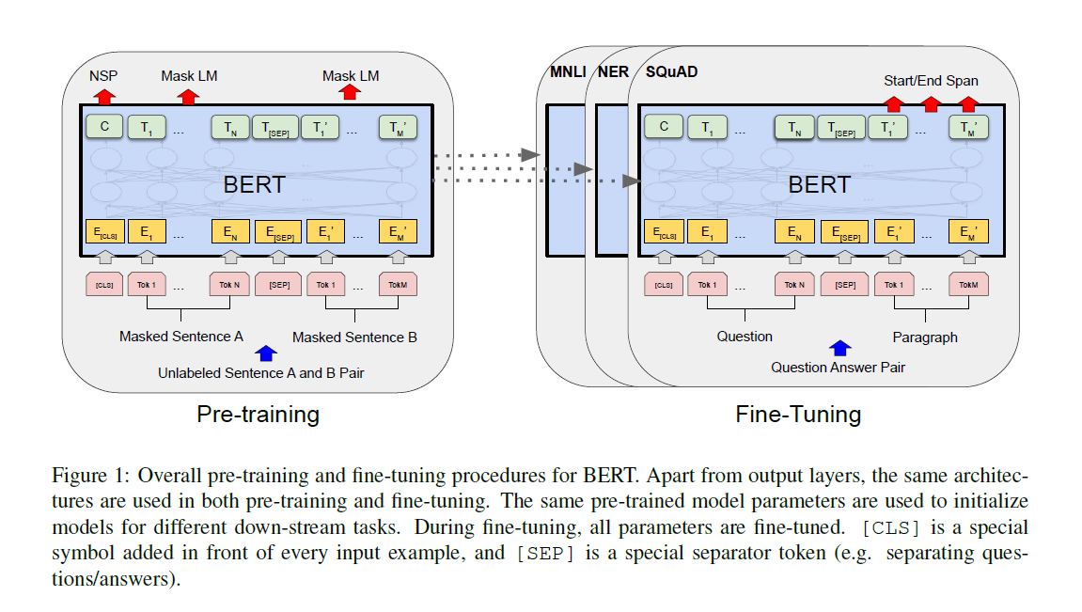
BERT: Pre-training of Deep Bidirectional Transformers for Language Understanding Jacob Devlin, Ming-Wei Chang, Kenton Lee, Kristina Toutanova Google AI Language

Slide 6
BERT: Pre-training of Deep Bidirectional Transformers for Language Understanding Jacob Devlin, Ming-Wei Chang, Kenton Lee, Kristina Toutanova Google AI Language
BERT’s model architecture is a multi-layer bidirectional Transformer encoder
The paper deals with two model sizes:
BERTBASE:
Number of layers of transformer block (L) =12
Hidden size (H) =768
Number of self attention heads (A) =12,
Total Parameters= 110M)
BERTLARGE (L=24, H=1024, A=16, Total Parameters=340M)
Number of layers of transformer block (L) =24
Hidden size (H) =1024
Number of self attention heads (A) =16
Total Parameters= 340 M

Slide 7
BERT: Pre-training of Deep Bidirectional Transformers for Language Understanding Jacob Devlin, Ming-Wei Chang, Kenton Lee, Kristina Toutanova Google AI Language
BERT fine-tuning results on 11 NLP tasks are presented:
Glue
SQuAD v.1.1
SQuaD v.2.2
SWAG
The paper demonstrates that bidirectional architectures pretrained on a large corpus can successfully tackle a broad set of NLP tasks.

Slide 8
CNN

Slide 9
Convolutional Neural Networks for Sentence Classification Yoon Kim New York University yhk255@nyu.edu
This paper presents a series of experiments with convolutional neural networks (CNN) trained on top of pre-trained word vectors for sentence-level classification tasks.
Simple CNN on static vectors achieves excellent results on multiple benchmarks.
Learning task-specific vectors through fine-tuning offers further gains in performance.
The model further propose a simple modification to the architecture to allow for the use of both task-specific and static vectors.
The CNN models proposed improve upon the state of the art on 4 out of 7 tasks, which include sentiment analysis and question classification.

Slide 10
Convolutional Neural Networks for Sentence Classification Yoon Kim New York University yhk255@nyu.edu
Source: https://cezannec.github.io/CNN_Text_Classification

Slide 11
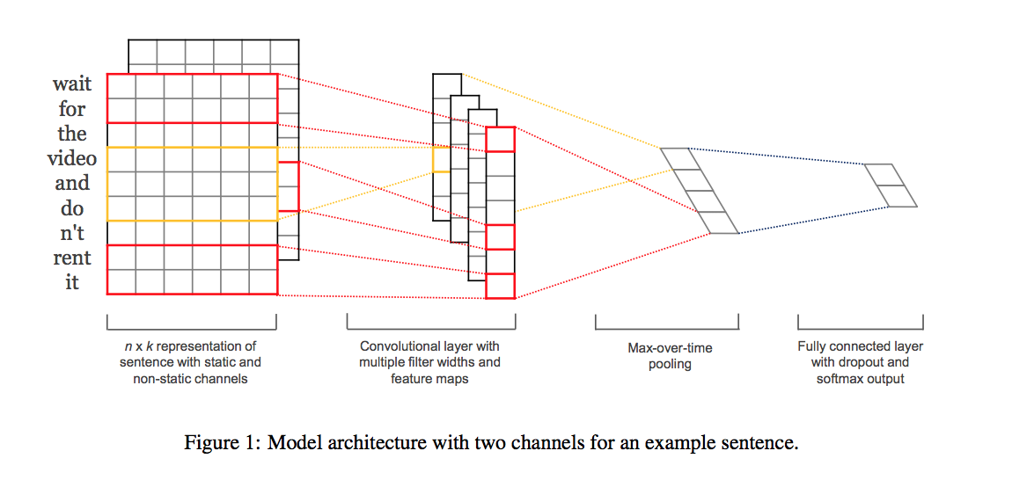
Convolutional Neural Networks for Sentence Classification Yoon Kim New York University yhk255@nyu.edu

Slide 12
Convolutional Neural Networks for Sentence Classification Yoon Kim New York University yhk255@nyu.edu
Datasets tested on:
MR: Movie reviews with one sentence per review. Classification involves detecting positive/ negative reviews
SST-1: Stanford Sentiment Treebank—an extension of MR but with train/dev/test splits provided and fine-grained labels (very positive, positive, neutral, negative, very negative)
SST-2: Same as SST-1 but with neutral reviews removed and binary labels.
Subj: Subjectivity dataset where the task is to classify a sentence as being subjective or objective
TREC: TREC question dataset—task involves classifying a question into 6 question types (whether the question is about person, location, numeric information, etc.)
CR: Customer reviews of various products (cameras, MP3s etc.). Task is to predict positive/ negative reviews

Slide 13
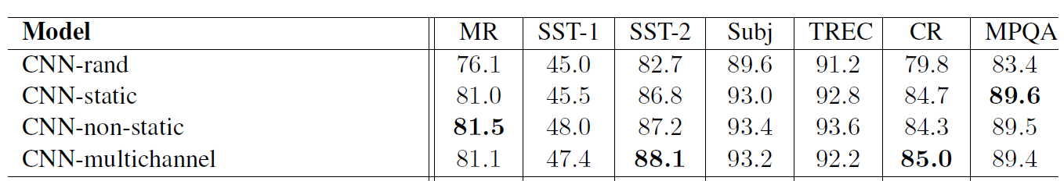
Convolutional Neural Networks for Sentence Classification Yoon Kim New York University yhk255@nyu.edu
Several variants of the model are tested:
CNN-rand: Baseline model where all words are randomly initialized and then modified during training.
CNN-static: A model with pre-trained vectors from word2vec. All words— including the unknown ones that are randomly initialized—are kept static and only the other parameters of the model are learned.
CNN-non-static: Same as above but the pretrained vectors are fine-tuned for each task.
CNN-multichannel: A model with two sets of word vectors. Each set of vectors is treated as a ‘channel’ and each filter is applied to both channels, but gradients are backpropagated only through one of the channels. Hence the model is able to fine-tune one set of vectors while keeping the other static. Both channels are initialized with word2vec.

Slide 14
Convolutional Neural Networks for Sentence Classification Yoon Kim New York University yhk255@nyu.edu
Despite little tuning of hyperparameters, a simple CNN with one layer of convolution performs remarkably well. Our results add to the well-established evidence that unsupervised pre-training of word vectors is an important ingredient in deep learning for NLP.

Slide 15
Supervised and Semi-Supervised Text Categorization using LSTM for Region Embeddings Rie Johnson RIEJOHNSON@GMAIL.COM RJ Research Consulting, Tarrytown NY, USA Tong Zhang TONGZHANG@BAIDU.COM Big Data Lab, Baidu Inc, Beijing, China
This paper is on text classification. Explores ways to improve text classification based on One-Hot CNN.
It takes the work on One-Hot CNN based text categorization model (Linear) and adds a non-linear feature generator consisting of ‘text region embeddings + Pooling’ to get better text categorization results.
LSTM was used to embed and extend the one-hot neural layers to make a more sophisticated region embedding with variable sizes to derive better classifications.
This paper explored this method with semi-supervised and supervised data.
The best results were obtained by combining region embeddings in the form of LSTM and convolution layers trained on unlabeled data.

Slide 16
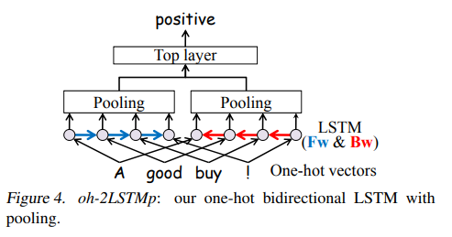
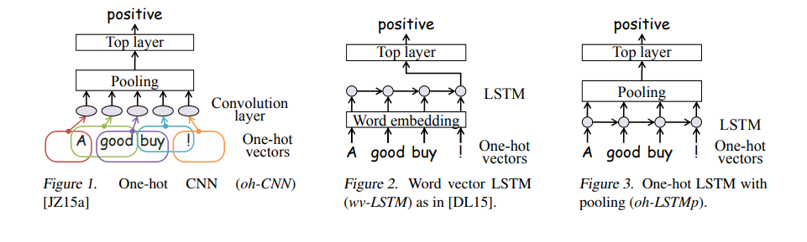
Supervised and Semi-Supervised Text Categorization using LSTM for Region Embeddings Rie Johnson RIEJOHNSON@GMAIL.COM RJ Research Consulting, Tarrytown NY, USA Tong Zhang TONGZHANG@BAIDU.COM Big Data Lab, Baidu Inc, Beijing, China The Models used to compare
In One-hot CNN – This had only one layer of fixed region of neurons. And one pooling layer.
Here the disadvantage is the number of input neurons (ex: region size is 5) is fixed.
Wv-LSTM is the traditional word vector based RNN neural network
Oh-LSTM is the One-hot LSTM which uses the word occurrences without using the vector embeddings.
Bi-directional one hot LSTM with pooling which uses one hot vectors for faster prediction

Slide 17
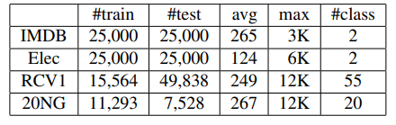
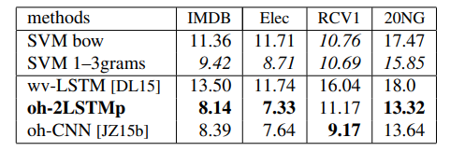
Supervised and Semi-Supervised Text Categorization using LSTM for Region Embeddings Rie Johnson RIEJOHNSON@GMAIL.COM RJ Research Consulting, Tarrytown NY, USA Tong Zhang TONGZHANG@BAIDU.COM Big Data Lab, Baidu Inc, Beijing, China Why Pooling instead of input/output gates?
The datasets used to compare:
Percentage of error in predicting the correct class.
The paper explores using the traditional word vector LSTM and the improved one-hot bidirectional LSTM with pooling and they got the lowest percentage of error in 3 of the 4 datasets used with better performance.
pooling has the merit of enabling faster training via chopping. Since we set the goal of LSTM to embedding text regions instead of documents, it is no longer crucial to go through the document from the beginning to the end sequentially. At the time of training, we can chop each document into segments of a fixed length that is sufficiently long (e.g., 50 or 100) and process all the segments in a mini batch in parallel as if these segments were individual documents. (Note that this is done only in the LSTM layer and pooling is done over the entire document.)

Slide 18
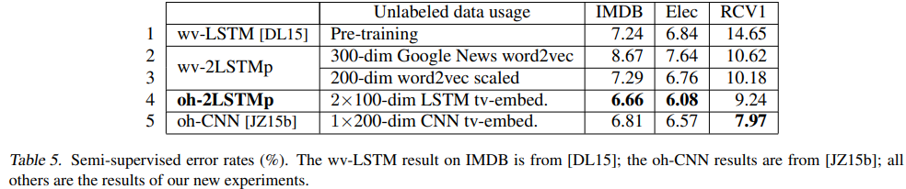
Supervised and Semi-Supervised Text Categorization using LSTM for Region Embeddings Rie Johnson RIEJOHNSON@GMAIL.COM RJ Research Consulting, Tarrytown NY, USA Tong Zhang TONGZHANG@BAIDU.COM Big Data Lab, Baidu Inc, Beijing, China Conclusion
We found this paper interesting as we were not able to get good accuracy using LSTM for predicting the categories of news articles in supervised learning.
LSTM also had the problem of document lengths. The optimal length that worked was about 100 words. Above which training took time and the accuracy didn’t improve.
This paper gave a way to divide the documents in 50 – 100 words each. Then apply the LSTM bi-directional way on each division.
Then apply the max pooling on the results of all the documents combined.
The paper also concluded that unidimensional CNN with 1000 input range and two CNN layers and max pooling can outperform on classification.
:

Slide 19
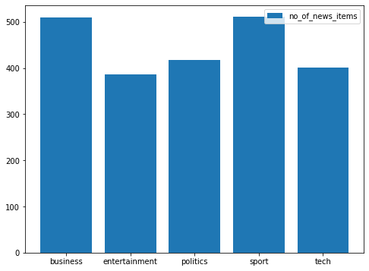
BBC News Dataset
2225 news articles
Roughly evenly distributed across:
Business
Entertainment
Politics
Sports
Technology
Objective: To build a model to classify news articles

Slide 20
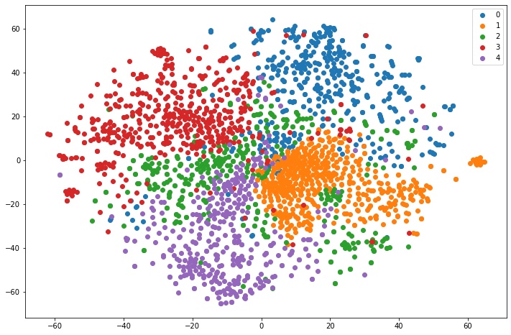
BBC News: BoW
Text was treated as a bag of words
Each article was converted as a vector of 3007 dimensions, using CountVectorizer
Various classifiers used
Test accuracy achieved:
KNN 0.69
SVC 0.96
Random Forest 0.86
Gradient Descent 0.96
Logistic Regression 0.97

Slide 21
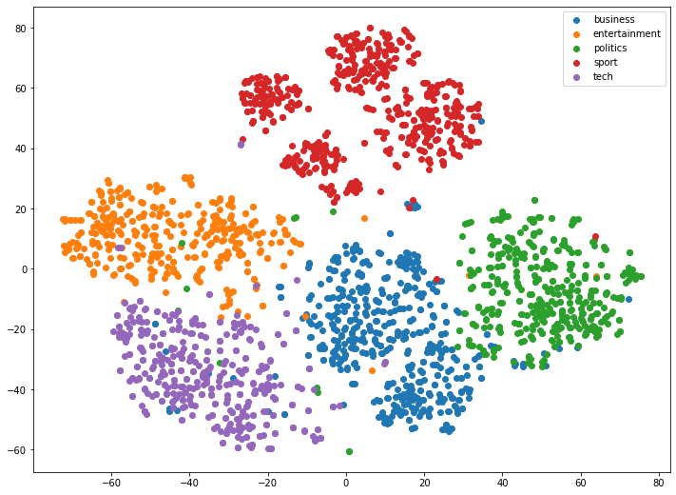
BBC News: TfIdf
Each article converted into vectors of 14,415 dimensions using SKLearn TfidfVectorizer
Various classifiers used
Accuracy achieved:
KNN 0.96
SVC 0.98
Random Forest 0.81
Gradient Descent 0.98
Logistic Regression 0.98

Slide 22
BBC News: CNN
Description | Values
input word vectors | fastText
embedding size | 300
filter sizes | (3, 4, 5)
num filters | (100, 100, 100)
activation | ReLU
pooling | 1-max pooling
dropout rate | 0.5
Text converted into embeddings using FastText
Each article padded to maximum length of 4862 words
3 convolution layers of kernel sizes 3, 4, 5
100 filters each
Output of each filter maxpooled to a single scalar. All such scalars concatenated to vector 300 dimensions
Linear layer with in_channels of 300 and out_channels of 5
Accuracy: 96.7% at 10 epochs

Slide 23
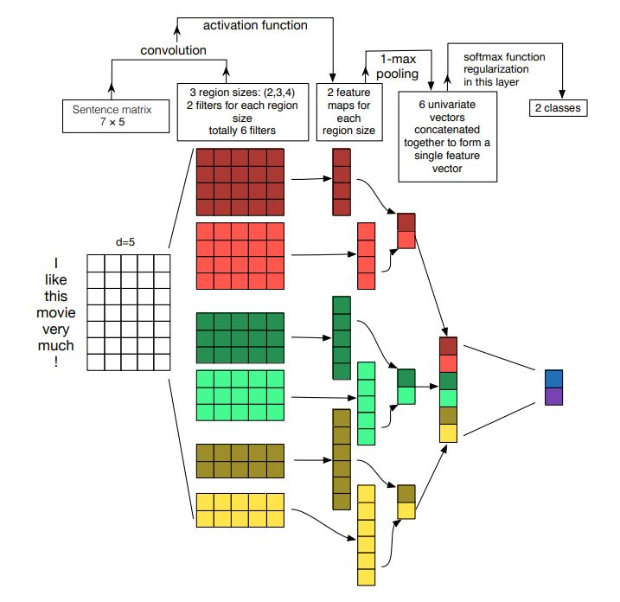
BBC News: CNN
In the current instance:
A: 4862 x 300 array
B: 100 nos of 3 x 300 kernels, 100 nos of 4 x 300 kernels and 100 nos of 5 x 300 kernels
C: 100 nos of 4,860-dimension vectors, 100 nos of 4,859-dimension vectors, 100 nos of 4,858 vectos
D: 300-dimension vector
E: 5-dimension vector
A
E
D
B
C
CNN Architecture (Source: Zhang, 2015)

Slide 24
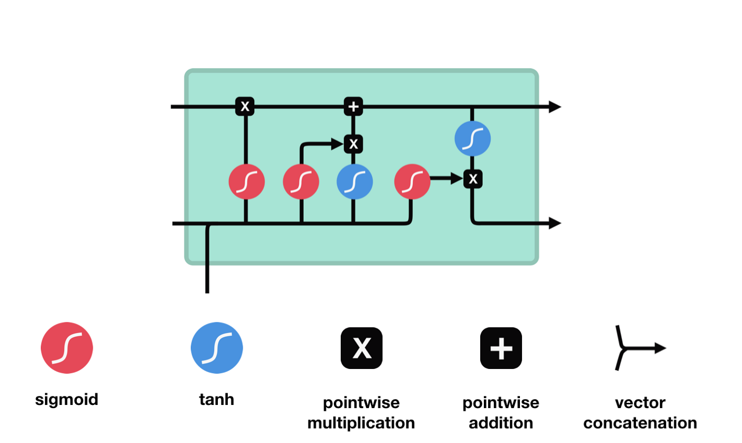
BBC News: LSTM
LSTM(
(embedding): Embedding(50108, 300)
(lstm): LSTM(300, 128, num_layers=2, batch_first=True)
(fc): Linear (in_features=128, out_features=5, bias=True)
(dropout): Dropout(p=0.5, in place=False)
)
Each article truncated to 100 words
Word embedded using FastText
Accuracy of 89.7% achieved

Slide 25
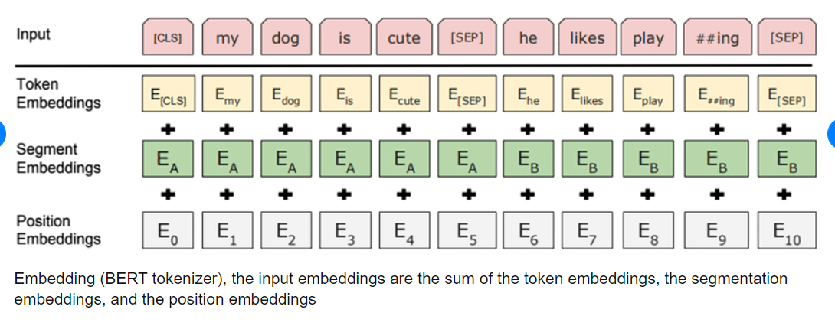
BBC News: Bert
Embedded using BertTokenizer
BertForSequenceClassification used to classify the articles
Test accuracy of 95%

Slide 26
Enron Dataset:
517400 emails from Enron
Fields extracted:
From address
To address
CC addresses
BCC addresses
Name of the person
Folder
Subject
Date
Body
Objective:
Classify into folders for each person
Challenges:
Each person has varying folders, while some have a few others have large numbers. In total, over 1000 folders
Large dataset, leading to crashing of the colab sessions

Slide 27
Enron: KMeans
60,000 emails were selected at random
Subject and body combined and TfidfVectorizer used to embed
From, To, CC, BCC, Name were treated as additional features
In total, 1065 features
1060 (tfidf embeddings of text)
5 additional features (from, to, cc, bcc, and name)
Various algorithms used to classify
KNN 64.0%
Random Forest 72.7%
Gradient Descent 81.0%
Logistic Regression 88.3%
SVC 80.3%
Challenges:
SVC takes too long to train. So eventually took a very small sample
Logistic Regression did not converge even at 500 iterations, so eventually settled for 100 iterations. It did not converge

Slide 28
Enron: Tfidf
60,000 emails were selected at random
Subject and body combined and TfidfVectorizer used to embed
From, To, CC, BCC, Name were treated as additional features
In total, 1065 features
1060 (tfidf embeddings of text)
5 additional features (from, to, cc, bcc, and name)
Various algorithms used to classify
KNN 64.0%
Random Forest 72.7%
Gradient Descent 81.0%
Logistic Regression 88.3%
SVC 80.3%
Challenges:
SVC takes too long to train. So eventually took a very small sample
Logistic Regression did not converge even at 500 iterations, so eventually settled for 100 iterations. It did not converge

Slide 29

Enron: LSTM
Text: 30 words from ‘Subject’ combined with 70 words from the ‘Body’
FastText used to embed the Text
LSTM applied on the text
Linear layers applied on output from LSTM combined with 5 additional features (From, To, CC, BCC, Name)
Results: Test Accuracy of 71.0% from 3 epochs
Simple LSTM without the 5 additional features returned an accuracy of

Slide 30
Enron: Bert
Text embedded using BertTokenizer
BertForSequenceClassification to classify
Accuracy:
How to incorporate additional features?

